Slide 1

AI Stock Insights

Slide 2

Executive Summary
Project Overview
We built an interactive stock analysis tool that empowers investors with actionable insights:
Trend Analysis: Visualized cumulative price changes and historical trends over 5 years.
Performance Comparison: Evaluated key metrics like Sharpe Ratio, Volatility, and CAGR to identify top-performing stocks.
Strategic Timing: Highlighted optimal days to trade based on daily price movements and volatility.
Stock Scoring System: Ranked stocks across financial metrics to simplify investment decisions.
Our project combines data-driven analysis with user-focused insights, offering a robust tool to navigate AI stock performance.

Slide 3

Ryan Brown
Data Collection
Visualization
Daniel Liu
Data Cleanup
Visualization
Danny Srour
Read.md file
Visualization
Github Version control
Austin Cappeta
Contributor
Visualization
Caleb Kelson
Contributor
Visualization
Cathy Schassberger
Contributor
Presentation

Slide 4
Project Approach
Planning & Goal Setting: Defined the objective to develop stock analysis code for AI companies.
Stock Selection & Data Collection: Selected 6 prominent AI companies with 5 years of historical data using Alpha Vantage API.
Data Cleaning & Exploration: Processed data to address missing values, outliers, and inconsistencies; analyzed trends and patterns.
Visualization & Reporting: Created interactive charts to showcase stock performance and insights.
Future Enhancements: Identified areas for future improvements.

Slide 5
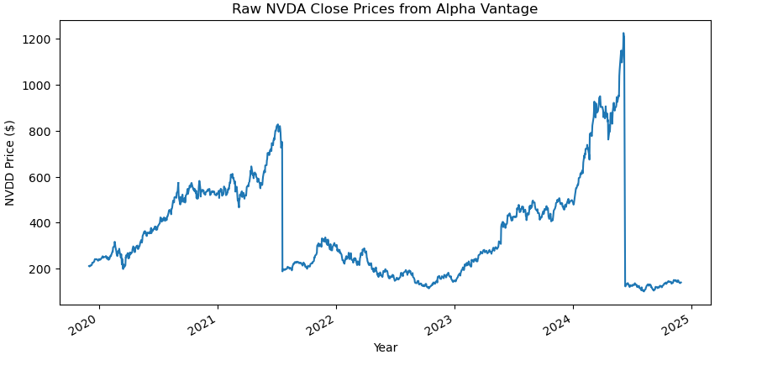
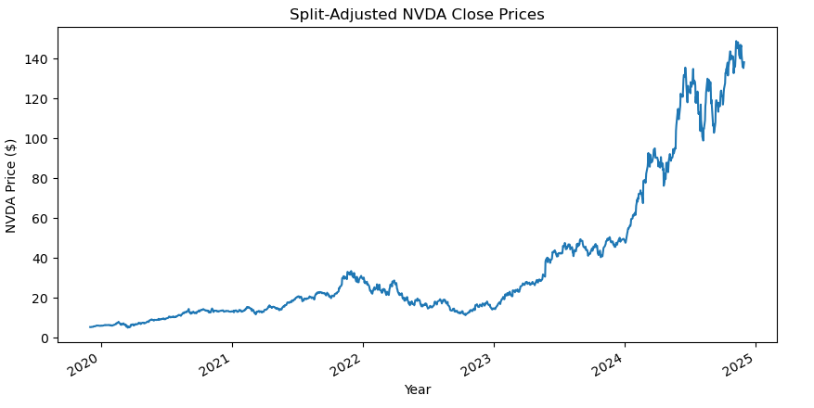
Data Collection and Cleanup
Data source: Alpha Vantage API
Inconsistency: Stock splits can cause distortion
4 out of 6 stocks had split(s) in the 5-year period
Example: NVDA
Split 1 - 4:1 7/20/2021
Split 2 - 10:1 6/10/2024
Cleanup solution: Adjust prices for its split(s)

Slide 6
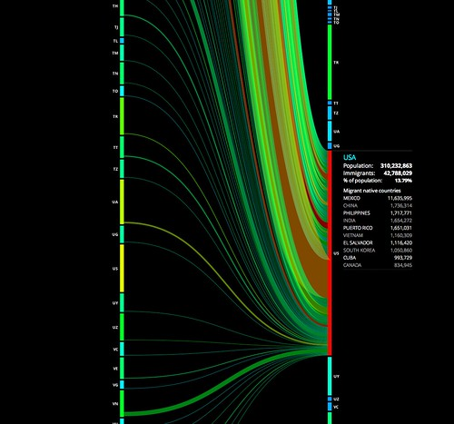
Explorations and Visualizations

Slide 7
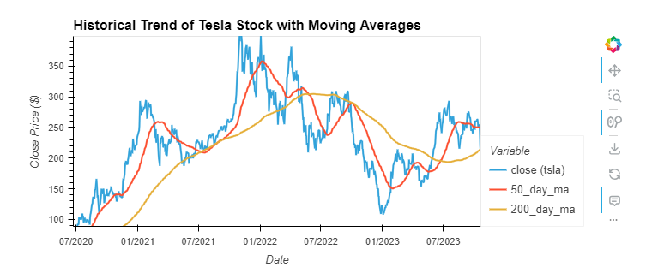
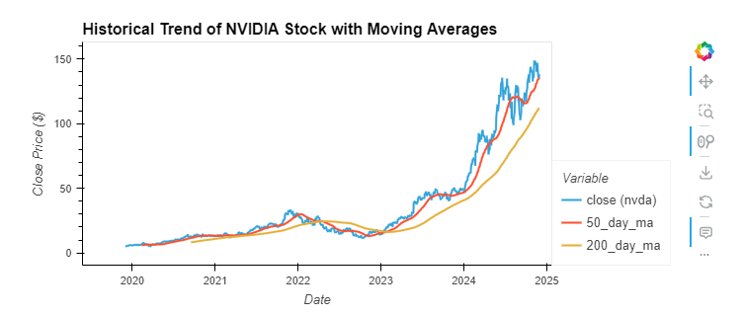
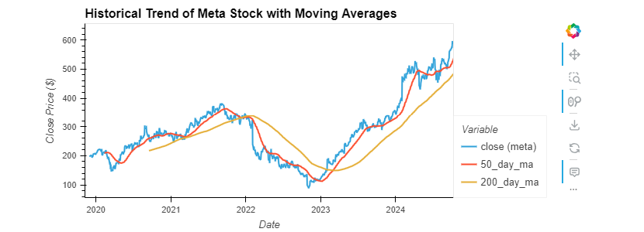
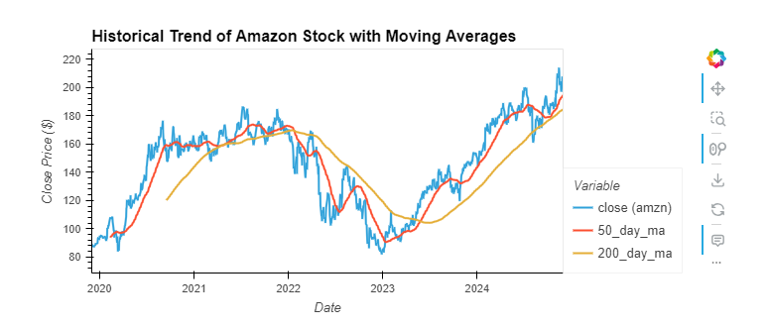
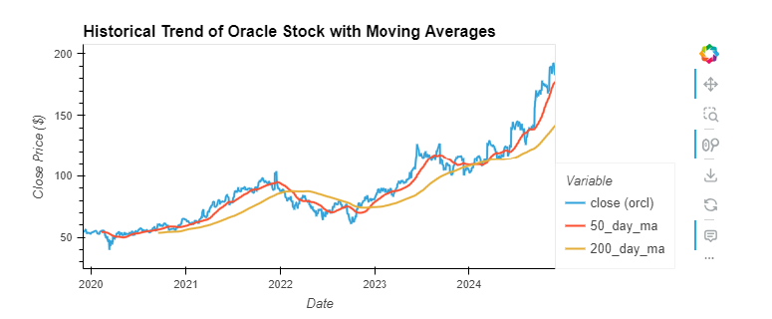
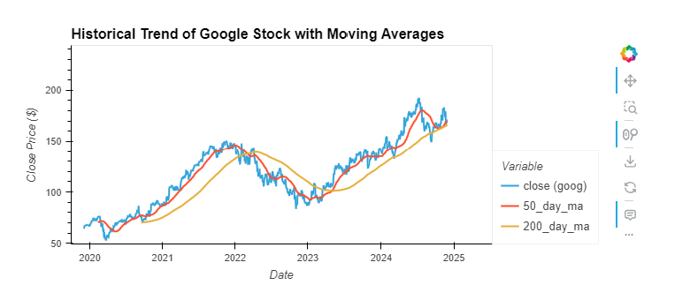
Historical Stock Performance (Last 5 Years)
Key Trends
Overall Growth: All six stocks grew despite market fluctuations in 2022.
Strong Recovery: Significant rebounds occurred in 2023 and 2024.
Top Performers: Nvidia and Meta saw the most notable price surges during this period.

Slide 8
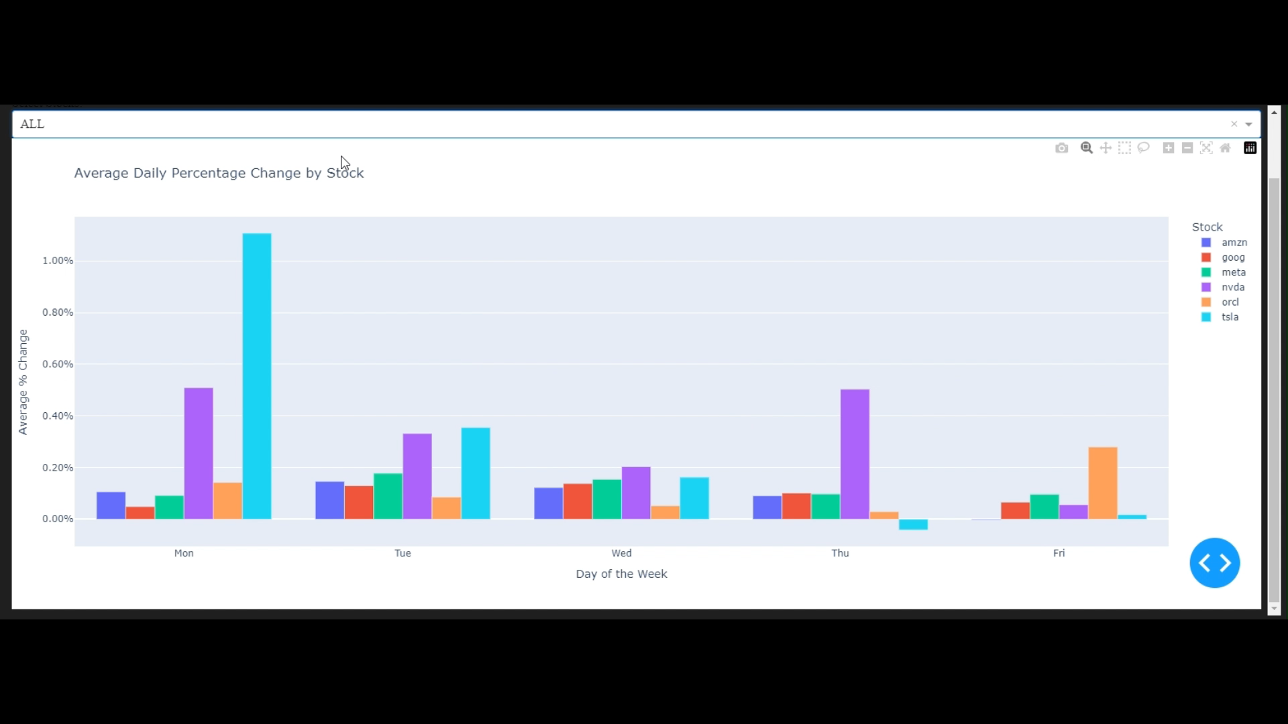
Analysis of Average Daily Percentage Change by Stock
Key Insights: Average Daily % Change
Avoid Tesla (TSLA) & Nvidia (NVDA) on Mondays: Sharp price spikes make it less ideal for buying.
Mid-Week Stability: Tuesday and Wednesday offer consistent trends for most stocks, including Amazon (AMZN) and Google (GOOG).
Meta (META): The least volatile stock, ideal for risk-averse investors.
Oracle (ORCL): Friday shows increased activity, indicating end-of-week trading optimism.

Slide 9
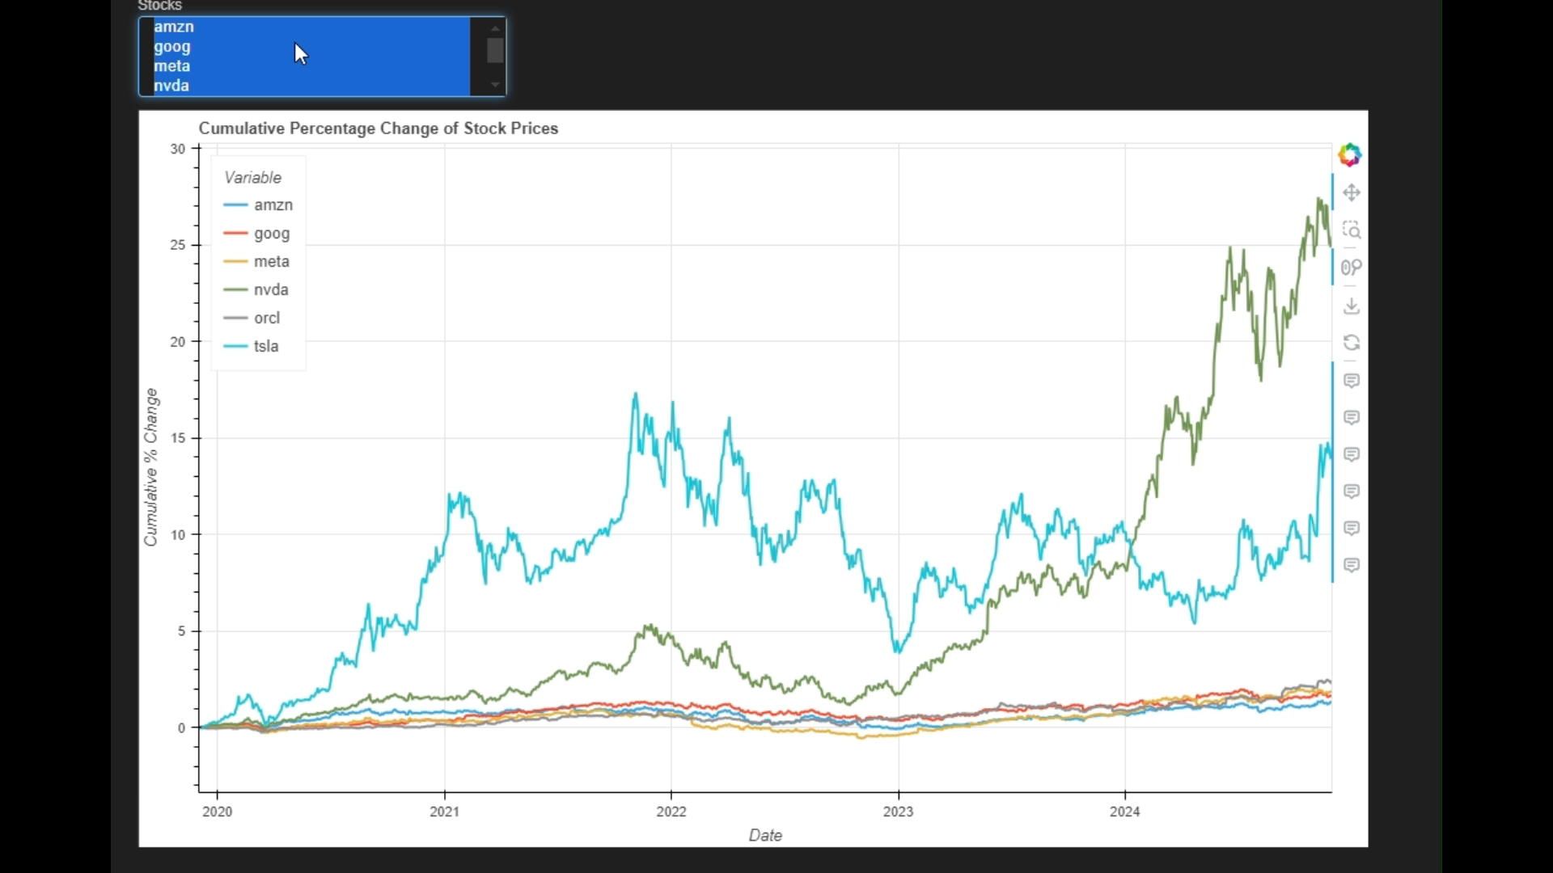
Cumulative Percentage Change of Stock Prices
Key Insights: Cumulative % Change
Nvidia (NVDA): Explosive growth (>2500%) since 2023, driven by AI advancements and GPU demand.
Tesla (TSLA): Strong long-term growth (~1500%) with notable volatility, offering high risk and reward.
Meta (META): Steady, moderate growth (300%-400%), ideal for consistent returns.
Amazon, Google & Oracle: Stable but slower growth (<200%), suited for conservative investors.

Slide 10
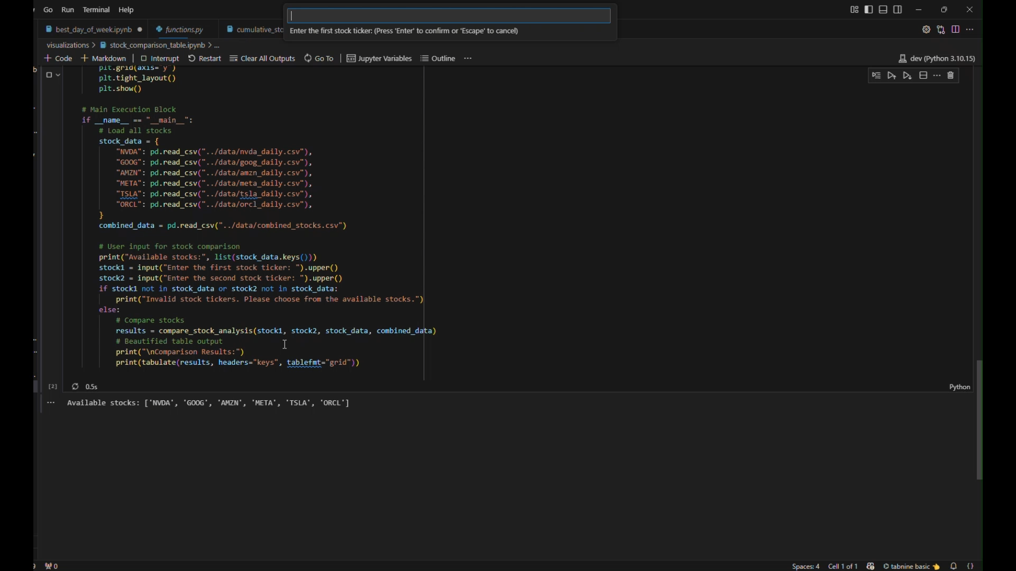
Stock Comparison and Points Ranking
Key Insights: Stock Comparison
Metrics Analyzed: Moving Average, Sharpe Ratio, Volatility, CAGR, RSI, Beta, and Max Drawdown.
Performance Highlights:
NVDA outperforms in 4 metrics, leading in Sharpe Ratio and RSI.
GOOG edges ahead with a higher Moving Average and slightly lower Max Drawdown.
Points System: NVDA scores 4 points, making it the better overall performer.
Investment Takeaway: NVDA shows stronger returns but with higher volatility; GOOG offers more stability.

Slide 11
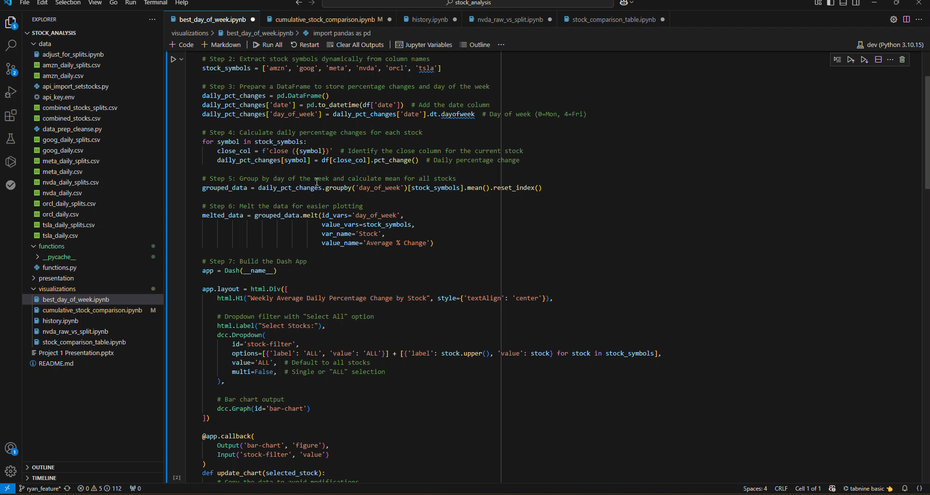
Conclusion and Demonstration
Comprehensive Insights: Analyzed six AI stocks, highlighting trends, volatility, and performance.
Top Performers: Nvidia showed exceptional growth; Meta and Google provided stable returns.
Optimal Timing: Mid-week stability favored most stocks; avoid high volatility on Mondays.
Performance Comparison: Points-based analysis identified the strongest investment options.
Future Scope: Expand to user-specified stocks, projected returns, and personalized recommendations.

Slide 12

Questions?
https://github.com/srourdanny/stock_analysis.git

